Slide 1
CSS Primer for SharePoint Web Designers
Working together with CSS and SharePoint
Notes:
This lecture begins with a discussion of HTML DOCTYPES used in SharePoint 2010 and provides a quick review session covering the syntax for creating and applying CSS rules. Emphasis is given to using modern CSS styling to layout Web pages with floating div elements and to control scrolling. This lecture discusses how SharePoint 2010 integrates a CSS file named corev4.css to provide a common set of CSS rules behind every page in SharePoint 2010 and teaches you the options you have for providing your own custom CSS rules which override and extend the CSS rules inside corev4.css. The lecture concludes with a discussion of how themes are implemented in SharePoint 2010 and discusses the limitations that prevents themes from providing an effective approach for creating a reusable branding solution.

Slide 2
Agenda
Why CSS?
CSS Fundamentals and Syntax
Tools for discovering CSS class names
Using CSS in SharePoint 2010
Themes

Slide 3
Fundamentals CSS concepts
Why is CSS important for web design?
Table and Font tags were popular in the 1990s
Web design now separates design from functionality
Tables are better suited to tabular data
Should you use Table and Font tags in modern design?
Why is CSS important with SharePoint?
OOTB SharePoint uses a LOT of CSS
Primary corev4.css file has over 100s of CSS rules
You use CSS to override default SharePoint branding
Notes:
The first generation of pages created using HTML had table tags to define the page layout and Font tags to style text. Things are much different these days because Web design now separates design from functionality using CSS. It is fair to say that anyone who wants to design Web pages must understand CSS.
All the styling provided on pages in SharePoint 2010 is controlled through CSS. There is a file we will look at later in this module named corev4.css that contains 100s of CSS rules. This means you have to know not only about CSS, but you have to know how SharePoint 2010 uses CSS.

Slide 4
A Brief History of HTML and CSS
HTML 3.2 and CSS 1.0 (circa 1997)
Browser wars between Netscape vs. Internet Explorer
HTML 4.01 and CSS 2.0 (circa 1999)
Exit Netscape – Enter FireFox, Opera, Safari, etc.
XHTML 1.0 and CSS 2.1 (circa 2000)
HTML content pages written as valid XML documents
HTML 5 and CSS 3.0 (circa 2005)
Rejects the constraints added by XHTML
Standardizes new HTML tags and JavaScript APIs
SharePoint 2010 lives here
Notes:
Both HTML and CSS have undergone quite a few changes with each new version. What makes things difficult for Web designers is that vendors such as Microsoft and their implementations often lag years behind the release of a specification.
While HTML 5 and CSS 3 are now getting a lot of attention as the latest and greatest, they are not supported in SharePoint 2010. Instead, SharePoint is based upon XHTML 1.0 and CSS 2.1. However, this is miles ahead of where we were with SharePoint 2007 which was based on HTML 3.2 and CSS 1. This fact in and of itself makes SharePoint 2010 a much easier and far more reliable platform than SharePoint 2007 when it comes to creating a custom branding solution.

Slide 5
DocTypes
What is a DocType?
Standard W3C instruction for browsers
Instruction to browser to use specific version of HTML/CSS
Pages without DocType render in Quirks mode (pre IE5.5)
Strict versus Transitional
Strict prohibits legacy code (e.g. no Font tags, tags must be closed)
<!DOCTYPE HTML PUBLIC "-//W3C//DTD HTML 4.01//EN” "http://www.w3.org/TR/html4/strict.dtd">
Transitional allows pages with legacy code to be compliant
<!DOCTYPE HTML PUBLIC "-//W3C//DTD HTML 4.01 Transitional//EN” "http://www.w3.org/TR/html4/loose.dtd">
Notes:
The top of a Web page can optionally contain a special element know as a DocType. The DocType provides an instruction to the browser to inform it which version of HTML and CSS to use. Any page that does not include a DocType renders in a special mode which is known to Web designers as quirks mode.
A DocType can be defined as strict or transitional. Strict prohibits legacy code such as Font tags and requires all tags to be properly closed. Transitional is forgiving because it allows pages with legacy code to be W3C compliant.

Slide 6
DocTypes and SharePoint
SharePoint 2010 pages use XHTML Strict 1.0
Most master pages defined with this DOCTYPE
<!DOCTYPE html PUBLIC "-//W3C//DTD XHTML 1.0 Strict//EN"
"http://www.w3.org/TR/xhtml1/DTD/xhtml1-strict.dtd">
SharePoint 2007 pages do not define a DocType
default.master does not define a DOCTYPE
Pages render in quirks mode
SharePoint pages will not pass W3C validators
You can’t make SharePoint pages standards compliant
You can make SharePoint pages standards friendly
Notes:
Master pages in SharePoint 2010 add a DOCTYPE element based on XHTML Strict 1.0. Therefore, pages in a SharePoint 2010 site instruct the browser to render their contents using the rules of XHTML 1.0 and CSS 2.1.
The SharePoint 2007 master page named default.master does not define a DOCTYPE. This means that pages in a SharePoint 2007 site render in quirks mode. It also means that pages in a SharePoint 2010 site which is running under the 2007 UI mode also render in quirks mode as well.
Note that pages in SharePoint 2010 sites will not pass the tests of the W3C validators. It is not worth the effort trying to make SharePoint pages standards compliant. However, you can take on the philosophy used by many expert Web designers. You can make SharePoint pages "standards friendly" trying to keep in the spirit of what the standards are trying to achieve with things like accessibility. However, trying to make pages standards compliant and be able to pass validators often involves far more effort than it is worth.

Slide 7
Browsers and Standards
Browser support categories for SharePoint 2010
Supported
Supported with known limitations
Not Tested
Supported Browsers
32-bit versions of IE7 and IE8
Supported Browsers with known limitations
64-bit versions of IE7 and IE8
Firefox 3.6 and Safari 4.04
Notes:
For more information, it is recommended you read the following TechNet article.
Plan Browser Support
http://technet.microsoft.com/en-us/library/cc263526.aspx

Slide 8
Agenda
Why CSS?
CSS Fundamentals and Syntax
Tools for discovering CSS class names
Using CSS in SharePoint 2010
Themes

Slide 9
How is CSS applied to HTML?
Inline Style
<p style="color: red;">The text is red</p>
Page-level Style Elements
<style type="text/css">
h1 { color: blue; }
</style>
External Style Sheets
<link href="customStyle.css" rel="stylesheet" type="text/css">
Notes:
CSS rules can be applied to a page in three different ways.
As an inline style on an HTML element
Using a style element which is usually added to the head section of the page
In a separate CSS file which is linked to from the page
Inline styles are discouraged as they go against the design principle of separating style and contents. Furthermore, inline styles override the other types of styles so their use leads to inflexible pages and elements which cannot be changed through an external CSS file.
Page-level style elements are preferred over inline because a single rule can apply style to many elements at once. While they do not provide high levels of reuse and flexibility as external style sheets, they can be used to apply CSS rules across multiple pages in SharePoint 2010 when used inside master pages and page layouts.
In most scenarios, external style sheets are recommended for your custom CSS rules because they provide the high levels of reuse and flexibility across pages, sites and site collections.

Slide 10
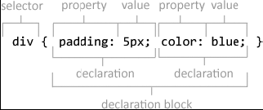
Style sheets are made up of Rules
Rules consist of
Selector – What HTML element is being styled
Declaration block - Sets of style properties and values
Declaration block can define multiple property/value pairs
CSS rule can have multiple selectors
div, p, h1 { color: blue; }
Notes:
A simple CSS rule consists of a selector and a declaration block. A selector determines what HTML element or elements are to be styled. The declaration block contains a set of one or more style properties and values.
A more complex CSS rule can contain multiple selectors that are separated by commas. The styles in the declaration block will be applied to any element that matches any of those styles.

Slide 11
Types of Selectors
Type Selectors
p { font-family: arial; }
Class Selectors
.myClass { color: red; }
p.myClass { color: blue; }
ID Selectors
<div id="myID">
#myID { color: green; }
Notes:
The three most selectors are:
Type selectors
Class selectors
ID selectors
Type selectors apply to HTML elements types. For example, the selector to match all HTML p elements look like this.
p { font-family: arial; }
Class selectors apply to HTML that have a specific class applied. For example, all HTML elements of any type with the class named myclass applied can be styled with this CSS rule.
.myClass { color: red; }
You can combine a type selector with a class selector. For example, all HTML elements of type p with the class named myclass applied can be styled with this CSS rule.
p.myClass { color: blue; }
ID selectors let you apply a style to exactly one element with a specified ID. For example you can apply style to a div with a id of myID by adding the # in front of the id value.
#myID { color: green; }

Slide 12
DEMO
Creating CSS Rules for a SharePoint Page

Slide 13
Types of Selectors
Descendent Selectors
<div>
<span>Hello</span> World
</div>
<style>
div p {
color: purple;
}
</style>
Notes:
A descendent selector combines a parent selector and a child selector. The example in the slide shows how to create a selector for all p elements that have been nested at any location inside a div element. Note that the descendent selector is not affected by how deep the child element is nested inside the parent element. In other words, the child element does not have to be nested directly inside the parent element but can also be nested inside of other child elements which exist inside the parent element.

Slide 14
Types of Selectors
Direct Child Selectors
Used to style only child elements (not grandchildren)
<div>
<a href="abc.htm">my link</a>
<span><a href="xyz.htm">my other link</a></span>
</div>
<style>
div > a {
color: purple;
}
</style>
Caveat – not supported in IE6
Notes:
A direct descendent selector combines a parent selector and a child selector using the CSS > operator. The example in the slide shows how to create a selector for all a elements that have been nested directly inside a div element. Note that the direct descendent selector is affected by how deep the child element is nested inside the parent element. In other words, the child element must be nested directly inside the parent element and cannot be nested inside of other child elements which exist inside the parent element.
The direct child selector was recently added to CSS and is not supported across all browsers. The one browsers failing to support this type of selector that causes the greatest concern to SharePoint 2010 designers is Internet Explorer 6.0. Note SharePoint 2010 uses the direct child selector in its standard CSS rules (e.g. Top link bar) which is one of the reasons why Internet Explorer 6.0 is not among the officially supported browsers.

Slide 15
Types of Selectors
Pseudo-Classes
a:link {color:#FF0000;} /* unvisited link */
a:visited {color:#00FF00;} /* visited link */
a:hover {color:#FF00FF;} /* mouse over link */
a:active {color:#0000FF;} /* selected link */
The Universal Selector
* {
margin: 0px;
padding: 0px;
}
Notes:
CSS also supports selectors created with pseudo-classes. The HTML a element has pseudo-classes for the various states it can be in as shown in the slide. Note that a:hover must be placed after a:link and a:visited in the CSS rule in order to be effective. Also a:active must be placed after a:hover in the CSS definition in order to be effective.
The universal selector (*) is used to apply a CSS to all elements on the page.

Slide 16
CSS Properties
Fonts
Font Family
font-family: Calibri, Arial, Helvetica, san-serif;
Font Size
font-size: 12px;
font-size: 1em;
Color
color: blue;
color: rgb(0,0,255);
color: #0000FF;
Text Decoration can be used to create interactivity on links
a {
text-decoration: none;
}
a:hover {
text-decoration: underline;
}
Notes:
CSS supports standard properties to style fonts and text.
The font-family property will use the first font in the list if it is supported on the current computer. If not, it then goes down the list and finds the first font available.
The font-size property can be specified in terms of pixels (px), points (pt) or a percentage of the original size (em).
The color property is used to change the color of the actual text.
The text-decoration property is often used remove the underline formatting of a link.

Slide 17
CSS Properties
Backgrounds used to impact design changes with little effort
background-color: blue;
background-image: url(‘/images/myimage.gif’);
background-repeat: repeat-x;
Borders can be set all in one or they can be set per side
border: 1px solid green;
border-left: 2px solid red;
border-right: 2px solid green;
border-top: 2px solid yellow;
border-bottom: 2px solid blue;
Notes:
The background of an element can be styled with respect to color and a background image. If you use a background image, you can control whether it is shown once or if it should repeat in the x and y directions. Repeating is used with fills to fill in large regions with smaller images.
Border can be specified in terms of width, type and color. Also you can set all four borders at once with the border property or you can set each of the four borders individually with properties such as border-left.

Slide 18
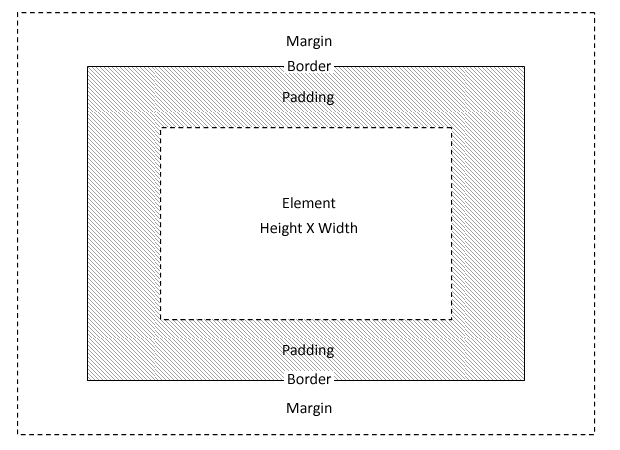
CSS Properties
Padding controls spacing between element and border
background colors and images show in this area
padding-top: 1px;
Margin controls spacing outside the border
It does not show background colors or images for the specific element
margin-top: 1px;
Notes:
The padding property controls spacing between element and its border. Note that the elements background colors and images show in this area.
The margin property controls spacing outside the border to create spacing between it and the elements around it. Note that an elements background color does not show up in the space. Also note that margin property values are not additive. For example, let's say one div has a margin-bottom property value of 10px and the div below it has a margin-top property value of 15px. The margin spacing between the div elements will be the greater value of 15px and not the added total of 25px.

Slide 19
CSS Properties
Wrapping can be controlled with CSS
white-space: nowrap;
Display used control spacing and hide elements
display: block;
display: inline;
display: inline-block;
display: none;
Notes:
The display property is often used to hide elements or to change their flow in the page. A display property value of none will hide an element and all its children. The type of HTML element will determine the default value for the display property. For example, a div element has a default display value of block while a span element has a default display property value of inline.
There are times when it makes sense to set the display property value to inline-block. This value prevent the element from being forced to a new line while still allowing other block characteristics such as having a border. This makes it possible to have div elements that flow from left to right as you will see in the lab associated with this lecture.

Slide 20
CSS Properties
Float
normal flow is from top to bottom
float property can remove element from normal flow
float: right;
Position
Static (default)
relative
absolute
Notes:
The float property controls the flow of elements a web page. The normal flow is from left to right and top to bottom. A float property can remove an element from this normal flow. For example, a float property of right floats the element to the top right of the containing element.
Each element also has a position property which by default has a value of static which means it flows normally down the page. Setting the position property to relative causes the element to be positioned relatively based on where it normally would be in the flow. Setting the position property to absolute causes the element to be positioned absolutely based on its parent element. When setting the position property to either relative or absolute you will want to set other properties such as top, bottom, left and/or right to control where the element moves.

Slide 21
DEMO
Using the float property to create columns

Slide 22
Inheritance in CSS
Inheritance push property values to descendants
Great for setting font and font color to something like body
Not all of the CSS properties support inheritance
!important rule can be really important!
!important takes precedence over standard cascade rules
Used by CSS included with SharePoint 2010
div {
color: red !important;
}
Notes:
Inheritance allows CSS property values of the element to apply to descendant elements as well. Some CSS properties support inheritance while other do not. Typically, the properties that support inheritance are the ones that affect text styling. For example, if you assign a specific type of font and font color to a div, all the elements inside take on those property values as well. However, CSS properties such as width and height do not support inheritance for obvious reasons. A online reference for CSS properties that support inheritance can be seen at the following URL:
http://www.w3.org/TR/CSS21/propidx.html
An !important declaration takes precedence over a normal declaration in the cascade rules. Declaring a shorthand property (e.g., 'background') to be "!important" is equivalent to declaring all of its sub-properties to be !important.

Slide 23
Understanding the Cascade
Cascade is a special algorithm used by browser
Used to figure out which styles to apply to elements
It examines styling conflicts and resolves them
Here is a high-level view of the cascade process
Find all style declarations applied to each element
Sort by origin and importance (including !important)
If origin and importance is the same, use specificity
If everything else is equal, rule declared last is winner
Notes:
A browser uses a special algorithm known the cascade to figure out which styles to apply to elements within a page. It begins by finding all style declarations applied to each element and then sorting by origin and importance (including !important).
If origin and importance is the same, then specificity is used to determine what wins the cascade. Specificity is determined via the following equation:
([The number of ID selectors] x 100) +
([The number of Class selectors] x 10) +
([The number of HTML selectors] x 1)
Finally, if all other steps are equivalent, the rule that is declared last is the winner

Slide 24
Agenda
Why CSS?
CSS Fundamentals and Syntax
Tools for discovering CSS class names
Using CSS in SharePoint 2010
Themes

Slide 25
Tools for Discovering CSS
Internet Explorer Developer tools
Built-into Internet Explorer 8 (and later)
Firebug
http://getfirebug.com
What do these allow you to do
Visually explore CSS class names, IDs, etc.
Notes:
As a Web designer, you must be able to apply styles to override the current formatting of various elements on Web pages. The two tools shown on the slide provides the means for reverse engineering a page and seeing the current CSS properties for each element. This makes it possible to see what selectors are needed to apply the styling you need.

Slide 26
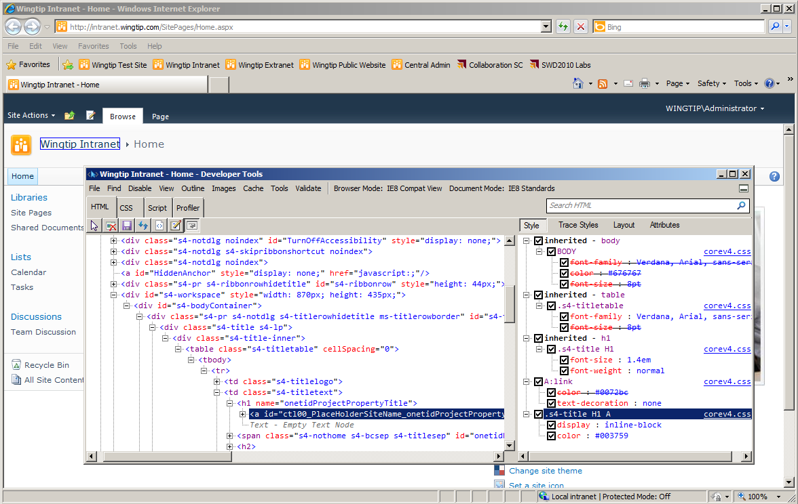
The IE Developer Tools
Notes:
The installation of Internet Explorer 8 comes with the Developer Tools which enables Web designer and developers to examine the HTML, CSS and JavaScript behind the current page.
For more information, go to:
http://msdn.microsoft.com/en-us/library/dd565628(v=VS.85).aspx

Slide 27
DEMO
Using The Internet Explorer 8
Developer Tools

Slide 28
Agenda
Why CSS?
CSS Fundamentals and Syntax
Tools for discovering CSS class names
Using CSS in SharePoint 2010
Themes

Slide 29
Understanding corev4.css
SharePoint core styles defined by corev4.css
Located in \TEMPLATE\LAYOUTS\1033\STYLES\Themable
Contains 1000s of lines of CCS class definitions
Classes used in standard SharePoint UI elements
Extending corev4.css
SharePoint themes (meant for end users)
Custom CCS files (meant for web designers)
Notes:
Every page in a SharePoint 2010 site is reliant on a special CSS file named core.v4.css. This file contains over 7000 lines of CSS code used by standard out-of-the-box elements in SharePoint 2010. It is important for you to have a basic understanding of what is inside. That is because it defines CSS rules that you must override and extend when working on a custom branding solution.
SharePoint 2010 provides a way to extend CSS using themes and using custom CSS files. Theme are meant for end users and will not have much value when creating a custom branding solution. Instead, you will use techniques of adding your custom CSS rules to site pages, master pages, page layouts and custom CSS files.

Slide 30
DEMO
Inspecting the corev4.css file

Slide 31
Adding Custom CSS Files
Where should CSS live in SharePoint?
Style Library greatest amount of flexibility
Can also be added to root of site or custom folder
In SharePointRoot directory (requires server access)
Notes:
Creating custom CSS files provide the greatest levels of flexibility and reuse. However, there are many different location in which you can deploy a custom CSS file so you must choose a location that is best for your situation.
In this course, we encourage deploy CSS files once per site collection in the Style Library of the top-level site because it provides the greatest amount of flexibility, it does not require access to the file system of the Web server. If you are working with SharePoint designer, you can also create a new CSS file at a location in a top site or a child site such as the root folder.
If you are developing SharePoint solutions that are deployed at the farm level, you can also deploy your CSS files inside the SharePointRoot directory at a location such as inside the layouts directory to achieve reuse across site collections. However, you have to be sure the farms you are targeting allow for such a deployment scheme.

Slide 32
Adding Custom CSS Files
Style sheets can linked from master pages
<head runat="server">
<!– link to OOTB css fils -->
<SharePoint:CssLink runat="server" Version="4"/>
<SharePoint:Theme runat="server"/>
<!-- custom css files -->
<link href="styles.css" rel="stylesheet" type="text/css" />
<SharePoint:CssRegistration name="<% $SPUrl:~Site/styles2.css %>" After="corev4.css" runat="server"/>
</head>
Style sheets can linked for specific pages
<asp:Content ContentPlaceHolderId="PlaceHolderAdditionalPageHead" runat="server">
<!-- custom css files -->
<link href="styles.css" rel="stylesheet" type="text/css" />
<SharePoint:CssRegistration name="<% $SPUrl:~Site/main.css %>" After="corev4.css" runat="server"/>
<asp:Content>
Notes:
In standard master pages such as v4.master, SharePoint 2010 uses special controls to add links to built-in CSS files. The SharePoint:CssLink control adds the link to corev4.css as well as a link to a custom file referenced by the AlternateCssUrl property of a site. The SharePoint:Theme control adds a link to the CSS file for a theme when a theme has been applied.
You can add a link to a CSS file in a master page using a simple link element as shown in the slide above. However, this can be problematic when creating master pages because you have to deal with pages at the root of the site as well as pages inside folders. Therefore, you cannot hardcode a path to the CSS file. You can use the CssRegistration control together with an $SPUrl expression to solve this problem. This makes it possible to calculate the path from a specific page to a CSS file at runtime.
Typically you want your custom CSS files to be linked after the corev4.css file so your styles override the standard SharePoint 2010 CSS rules. Therefore, you should include the After attribute with the CssRegistration control and give it a value of corev4.css .
In some cases such as when linking a single page to a CSS file you can use a simple link because you known the path from that one page to the CSS file. However, you can still use the the CssRegistration control and an $SPUrl expression if you would rather have SharePoint 2010 figure out the relative path at run time.

Slide 33
Agenda
Why CSS?
CSS Fundamentals and Syntax
Tools for discovering CSS class names
Using CSS in SharePoint 2010
Themes

Slide 34
What are Themes?
What is a theme?
A simple set of styling rules for SharePoint 2010 sites
How do theme work?
Theme settings layer on top of corev4.css
Certain colors and font settings substituted on the fly
Theme settings stored in content DB
Themes are different than in SharePoint 2007
Disclaimer – 2007 themes do not work in 2010!
Notes:
A SharePoint 2010 theme is a set of styling rules that can quickly be applied to all the pages within a site. A theme represents a layer on top of corev4.css. The actual mechanism used SharePoint 2010 is to create a copy of corev4.css on the fly and to substitute in certain colors and font settings. Themes and theme settings are stored in content DB.
Note that themes in SharePoint 2010 are completely different than they were in SharePoint 2007. Unfortunately, any work done to create custom themes in SharePoint 2007 cannot be migrated to any extend into SharePoint 2010.

Slide 35
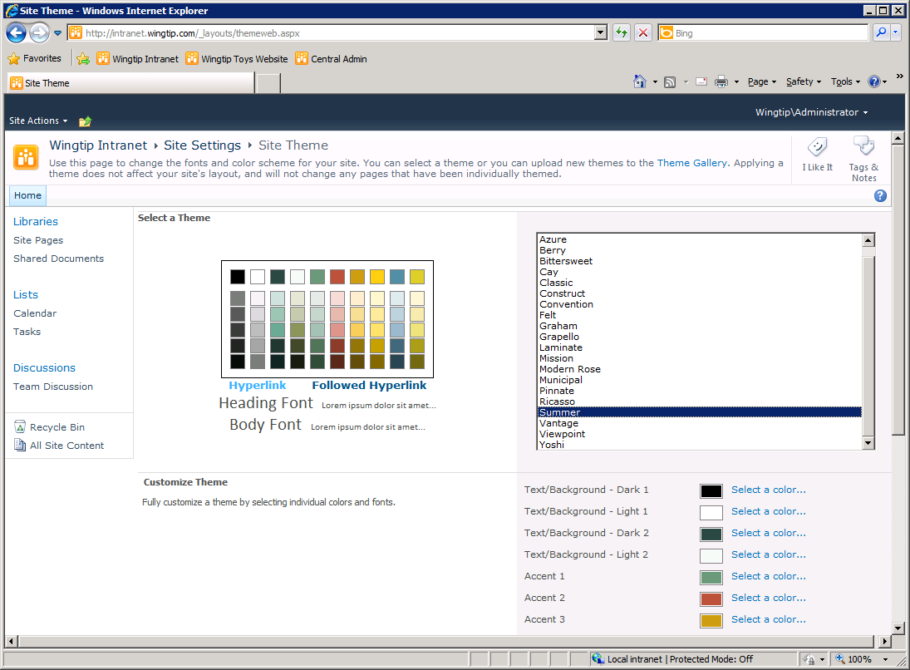
Applying a Theme to a SharePoint site
Notes:
This slide show the Site Theme page that allows a user to select and apply one of the standard themes included with SharePoint 2010. Note that SharePoint Server 2010 also extends the behavior of themes to allow users to customize them through the browser.

Slide 36
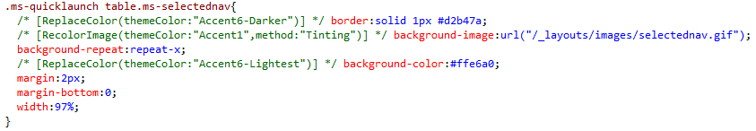
Theme Comments
There is a themable version of corev4.css
Source file at _layouts/1033/STYLES/Themable/corev4.css
Themed version of corev4.css copied into site
Three Types of Theme Substitution Comment
ReplaceFont
ReplaceColor
RecolorImage
Notes:
There is a themable version of the standard CSS file named corev4.css which is deployed at the location of _layouts/1033/STYLES/Themable/corev4.css. When a theme is applied, SharePoint 2010 makes a copy of this file, substitutes its fonts and colors and stores it in the content database. The substitution algorithm looks for these three types of comments.
ReplaceFont
ReplaceColor
RecolorImage
While there was a good deal of reuse that could be achieved by themes as they were implemented in SharePoint 2007, the same cannot be said for the new theme architecture in SharePoint 2010. Unfortunately, themes do not provide a effective mechanism for Web designers and developers creating branding solutions for SharePoint 2010. Instead, they are really meant for end users to make quick and dirty changes. For this reason, themes in SharePoint 2010 will not be discussed anymore in this course.

Slide 37
DEMO
Applying a SharePoint Theme

Slide 38
Agenda
Why CSS?
CSS Fundamentals and Syntax
Tools for discovering CSS class names
Using CSS in SharePoint 2010
Themes

